Slide 1
Start a workshop. Change the world.
Notes:
Ilén Zazueta-Hall. Director of Leadership Development, Raislbridge.org
(day job: Sr. SW Product Manager, Enphase Energy)

Slide 2
transparency
diversity
collaboration
Notes:
Principles of OSS (and OS_) Open source is more than just a software development model, it’s a way of looking at the world that emphasizes transparency, collaboration, and diversity. This way of looking at the world leads to better, more innovative, more effective solutions to the problems we all face.

Slide 3
diversity
Notes:
Group diversity leads to better decision outcomes, and this has been shown in a variety of settings, occupations, and organizations [15, 16], and also applies to group task performance [17, 18] and to creativity and innovation [19]. Diversity is beneficial because a variety of opinions, backgrounds, and thinking styles and their integration into the solution are what contribute to better decision outcomes.
A recent industry report estimates that by 2012, teams with gender diversity will double their chances of exceeding performance expectations when compared to all male teams [10].

Slide 4
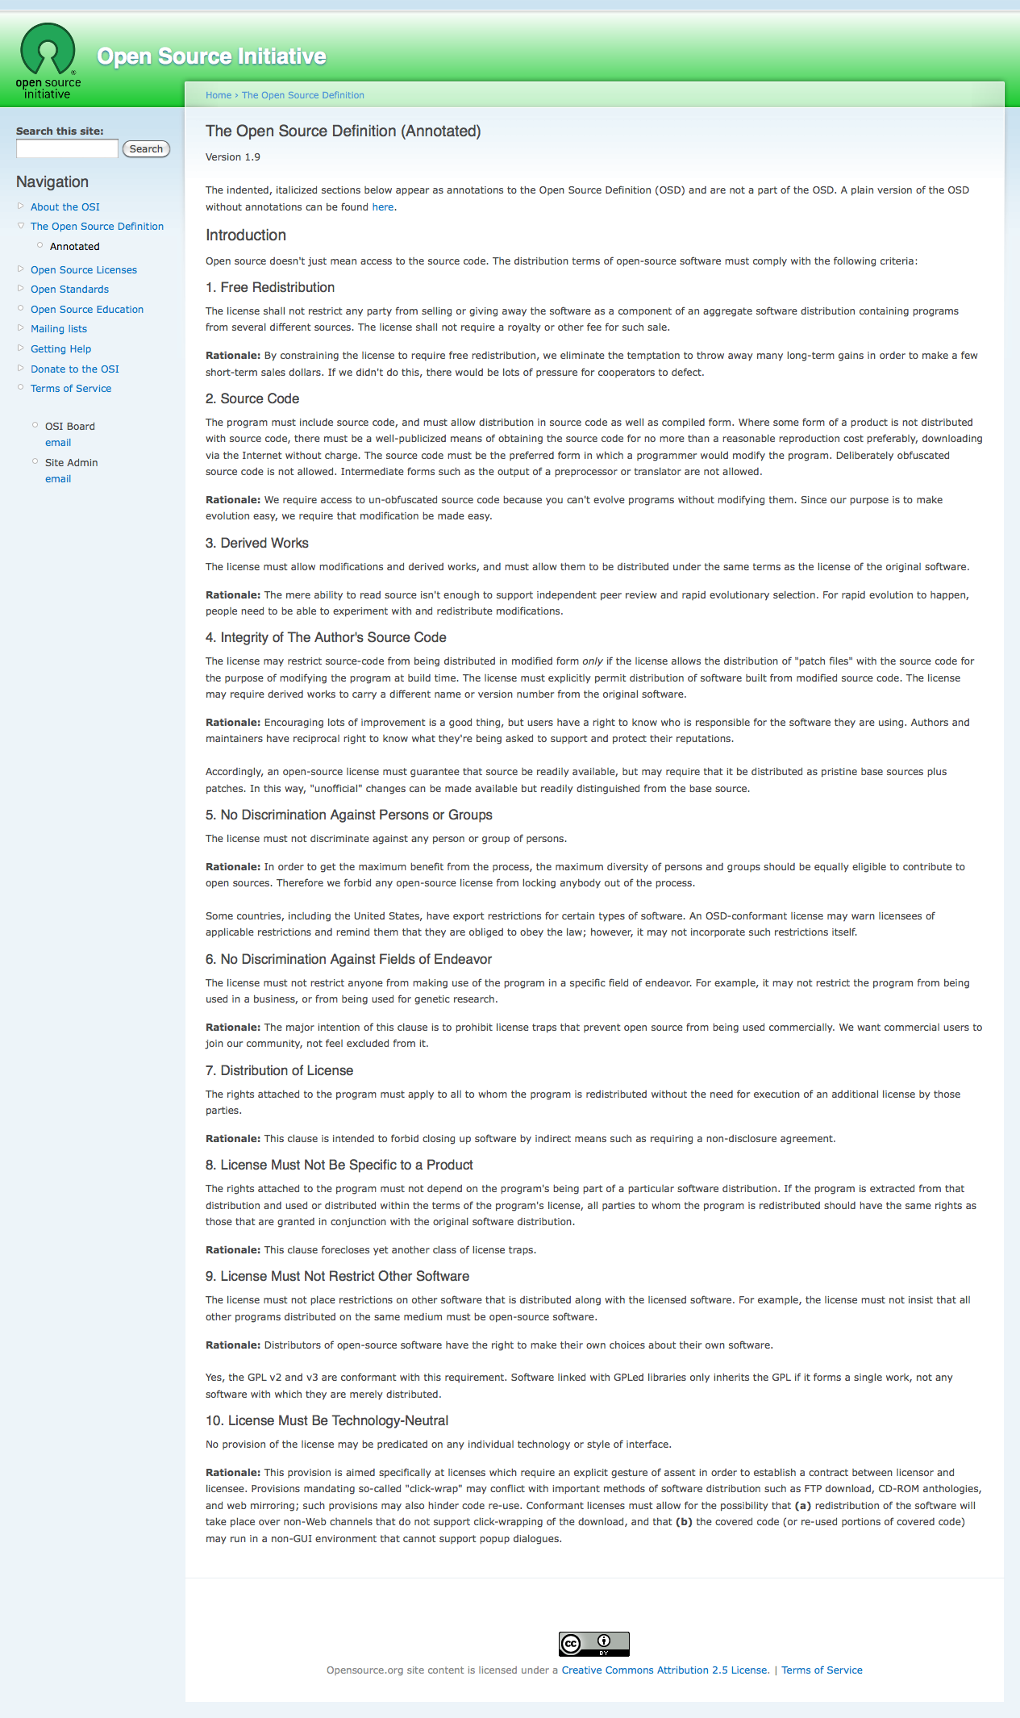
“In order to get the maximum benefit from the process, the maximum diversity of persons and groups should be equally eligible to contribute to open sources.”
Notes:
Annotated version of the Open Source Initiative’s Open Source Definition

Slide 5
diversity
^{ROCKS}
Notes:
Scott Paige – inwardly diverse groups solve problems better than experts. Difficult problems, diverse people need to have commonalities. Innovation
Stereotype effect on Computer Science AP test. Joshua Erinson NYU.
Group diversity leads to better decision outcomes, and this has been shown in a variety of settings, occupations, and organizations [15, 16], and also applies to group task performance [17, 18] and to creativity and innovation [19]. Diversity is beneficial because a variety of opinions, backgrounds, and thinking styles and their integration into the solution are what contribute to better decision outcomes. A recent industry report estimates that by 2012, teams with gender diversity will double their chances of exceeding performance expectations when compared to all male teams [10].
(anitaborg.org – business case for diversity)
http://anitaborg.org/files/businesscasegenderdiversity.pdf

Slide 6
58%
Notes:
Percentage of women in the US professional workforce.
Half of all consumers are women.
We want OS to go mainstream.
Diversity is needed.

Slide 7
Notes:
Women influence 80% of consumer spending decisions, and yet 90% of technology products and services are designed by men [10]. Including women in the technological design process means more competitive products in the marketplace. (anitaborg.org – business case for diversity)

Slide 8
25%
Notes:
Number of women in the US computer industry overall.

Slide 9
Notes:
Only 19 percent of those who took the computer science A.P. exam in 2010 were women. This is not because women think “math class is tough,” as a Barbie once famously, and unfortunately, lamented; girls actually sat for 49 percent of A.P. calculus tests.

Slide 10
2%*
*(1.5%, but let’s round up…)
Notes:
Note that this is research from a few years back and actual percentages vary widely. FLOSS Survey

Slide 12
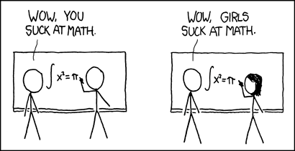
http://xkcd.com/385/
Notes:
If less than 16% of a visible minority, people will identify the speaker with their group. Need 16% to be identified as an individual. 85:15 (16%)
Related to the extra scrutiny received from being different is the burden of being a symbol or token of your gender or racial group. Tokens are under-represented members in a group. Because of their small numbers, the rest of the group puts them in the position of representing their category, whether they want to or not.
Majority and Token Minority Group Relationships: Power Acquisition and Communication
Gail Theus Fairhurst and B. Kay Snavely
The Academy of Management Review
Vol. 8, No. 2 (Apr., 1983), pp. 292-300
(article consists of 9 pages)
Only 19 percent of those who took the computer science A.P. exam in 2010 were women. This is not because women think “math class is tough,” as a Barbie once famously, and unfortunately, lamented; girls actually sat for 49 percent of A.P. calculus tests.

Slide 13
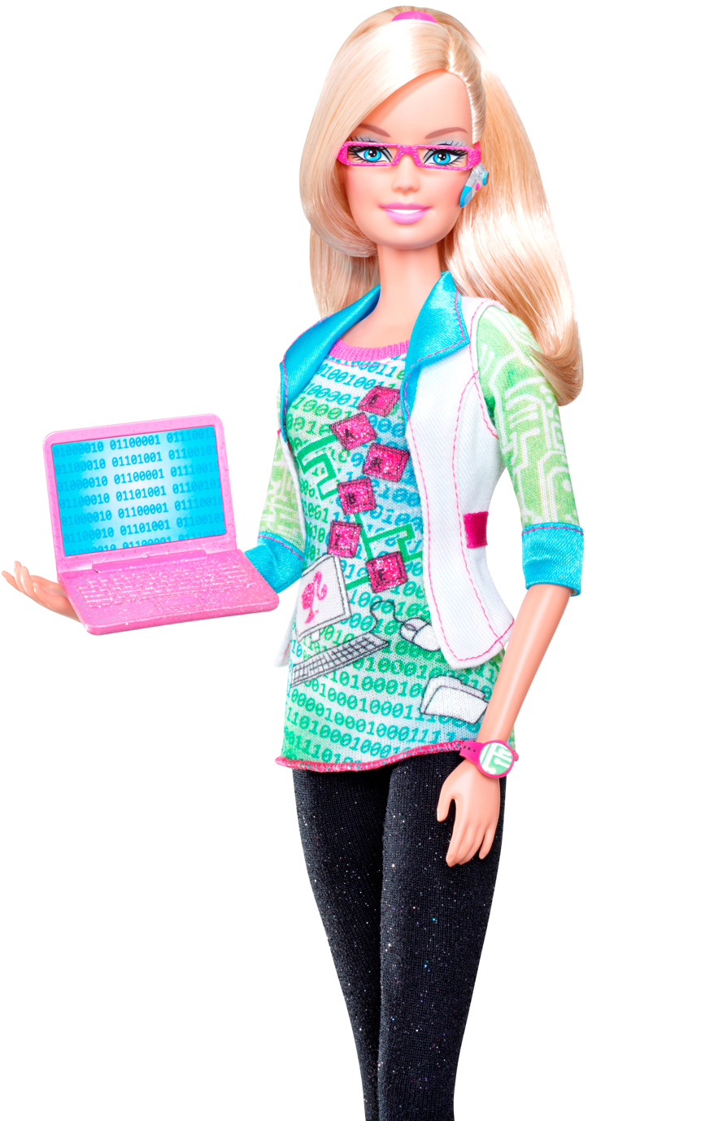
Notes:
Token practices served to perpetuate inequality by maintaining individual mobility beliefs and organizational identification. Token practices distort perceptions of fairness in both women and men. For women, token practices make group boundaries seem more negotiable than they actually are, while for men token practices legitimize their group's dominance.
Danaher, K. and Branscombe, N. R. (2010), Maintaining the system with tokenism: Bolstering individual mobility beliefs and identification with a discriminatory organization. British Journal of Social Psychology, 49: 343–362. doi: 10.1348/014466609X457530

Slide 14
tokenism
^{SUCKS}
Notes:
Commitment model in hiring (common start up model relies on fit)

Slide 16


Notes:
Sarah Allen and Sarah Mei at GoGaRuCo in 2009.
There are more Women programmers than Ruby programmers in the Bay area.

Slide 17

Notes:
Image cc
http://www.flickr.com/photos/kchrist/27675284/sizes/o/in/photostream/
Some rights reserved by Kenn Wilson

Slide 18
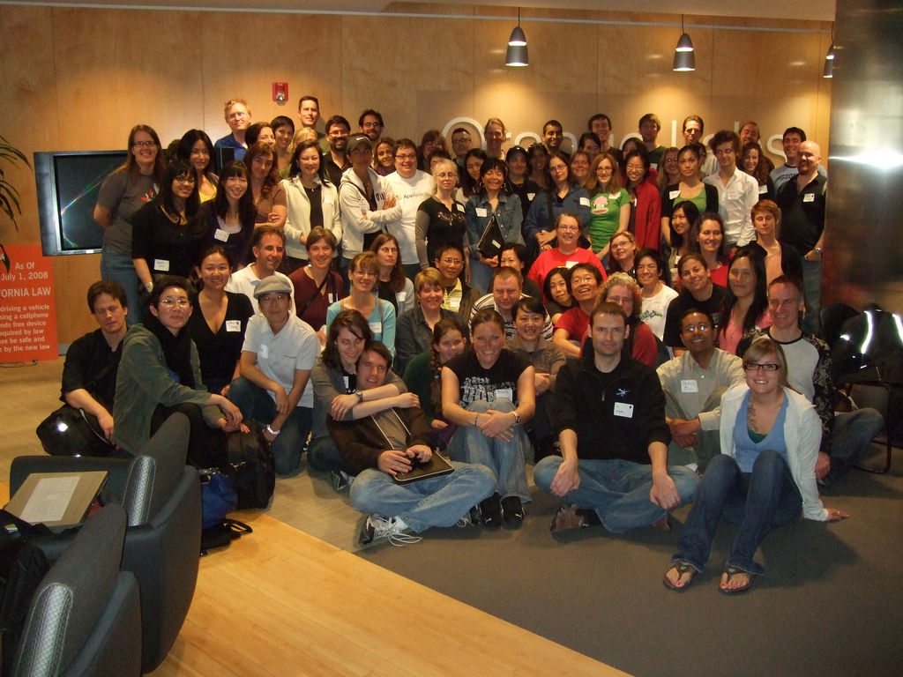
Notes:
With the force of the community behind them, the first workshop became a bold move with 62 attendees, 15 volunteers, and 7 simultaneous classes.
OrangeLabs
Heroku
Students of all kinds. Including me.

Slide 19

Learning resources, mentors and workshops should be freely available to everyone, whether absolute beginner or professional seeking more awesomeness.
Notes:
Railsbridge started at same time as the workshops.
Took on the workshop project, organized behind it.
Students of all kinds.

Slide 21
18%

Slide 22
diversity
^{ROCKS}
Notes:
More vibrant community; meetups every week. People connecting socially in ways they wouldn’t have otherwise.
More welcoming not just to women, but to men.

Slide 23
seven(7)
^{ingredients}
Notes:
Women influence 80% of consumer spending decisions, and yet 90% of technology products and services are designed by men [10]. Including women in the technological design process means more competitive products in the marketplace.
Group diversity leads to better decision outcomes, and this has been shown in a variety of settings, occupations, and organizations [15, 16], and also applies to group task performance [17, 18] and to creativity and innovation [19]. Diversity is beneficial because a variety of opinions, backgrounds, and thinking styles and their integration into the solution are what contribute to better decision outcomes.
A recent industry report estimates that by 2012, teams with gender diversity will double their chances of exceeding performance expectations when compared to all male teams [10].

Slide 24
leaders/core team
ecosystem
teacher (or two)
a pool of local experts
location
funds
childcare
Notes:
Sign up for ruby
Need to be part of the community you want to change. – characteristics of ecosystem.
For it to be successful, the workshop needs to be part of an ecosystem. It seems to work best when there is a community, events and resources available locally. For Ruby and women, it seems that a regular in-person meeting makes a big difference. If there isn't already a monthly meetup, plan to start one after the workshop or perhaps a safe-place-to-code like the Berkman Center code crunch. If you have a large enough community and a founding team with stamina, plan a series of workshops, so that workshop graduates can come back an TA the next workshop. Learn, understand, practice, teach is a powerful sequence. Women respond to need more than self-promotion. What they won't do for themselves, they will do for a like-minded community.
to draw upon (meetup, user group, local companies/consultants that use Rails)

Slide 25
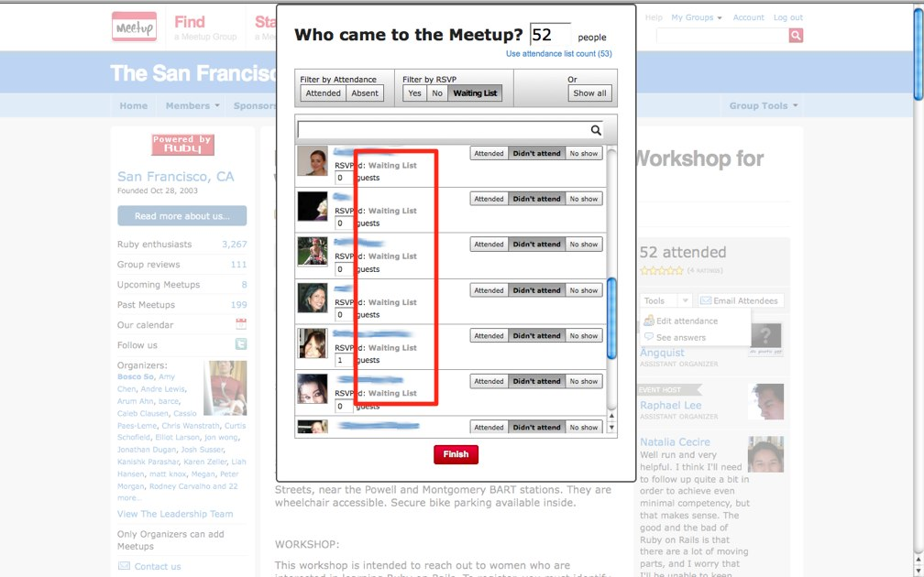
What about students?
Notes:
The other ingredient. Students. There’s always a waiting list.

Slide 26
ONE(1)
^{basic recipe}
Notes:
This is how we do it. It’s not the only way, but it works really well for us and I want you to see how easy it is.

Slide 27
Train teachers
Prep at the Install-fest
Hold the Workshop
Celebrate at the after party
Follow up with a Hackfest
Notes:
Food, After Party. Hooking participants into the Ecosystem. Ecosystem = interactions and relationships between elements.
This is not a professionally taught class. It’s a community coming together – vulnerability creates connection with students.
Students socializing with teachers. Makes people feel comfortable coming to an event.
It’s about removing barriers to joining the community.

Slide 28
iterate
^{CURRICULUM}
Notes:
At the first workshop there was no curriculum because there was disagreement about what to teach and not enough time to resolve it. There was an app and a vague outline. Different teachers taught different stuff. Chaos is good!
It’s okay that they don’t learn what you want to teach them.
You don’t have to teach the curriculum… It’s better to respond to your group.

Slide 29
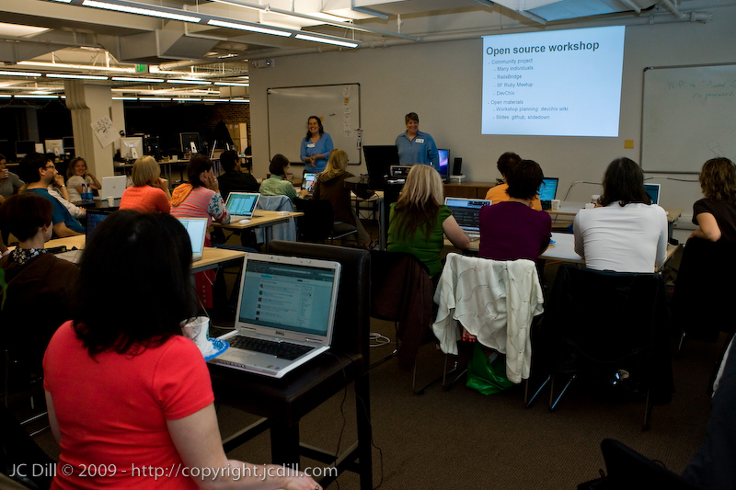
Notes:
Curriculum is completely open source.
Available on devchix wiki and github.
Tools we'll be working with
rails
rake: like make for Ruby. An easy way to run tasks.
git: source code control.
database: we'll use SQLite, but could be any relational database.
editor: KomodoEdit.
heroku: free Rails hosting.
Schedule
9:00-9:30 Sign in, get coffee
9:30-10:00 Intro
10:00-10:50 Session 1
11:00-12:00 Session 2
12:00-1:00 Lunch
1:00-2:15 Session 3
2:30-3:30 Session 4
3:30-4:00 Wrap up & final questions
4:30- Celebrate

Slide 30
Notes:
Intro to Ruby OR Intro to programming concepts
Build and deploy a web application
Add topics
Vote on a topic
Register and login

Slide 31
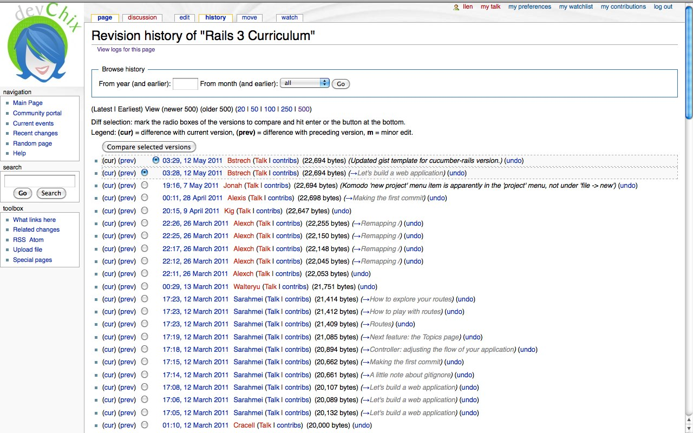

Slide 32
http://www.wiki.devchix.com/index.php?title=Rails_3_Curriculum
https://github.com/railsbridge

Slide 33
iterate
^{LOGISTICS}
Notes:
Women influence 80% of consumer spending decisions, and yet 90% of technology products and services are designed by men [10]. Including women in the technological design process means more competitive products in the marketplace.
Group diversity leads to better decision outcomes, and this has been shown in a variety of settings, occupations, and organizations [15, 16], and also applies to group task performance [17, 18] and to creativity and innovation [19]. Diversity is beneficial because a variety of opinions, backgrounds, and thinking styles and their integration into the solution are what contribute to better decision outcomes.
A recent industry report estimates that by 2012, teams with gender diversity will double their chances of exceeding performance expectations when compared to all male teams [10].

Slide 34
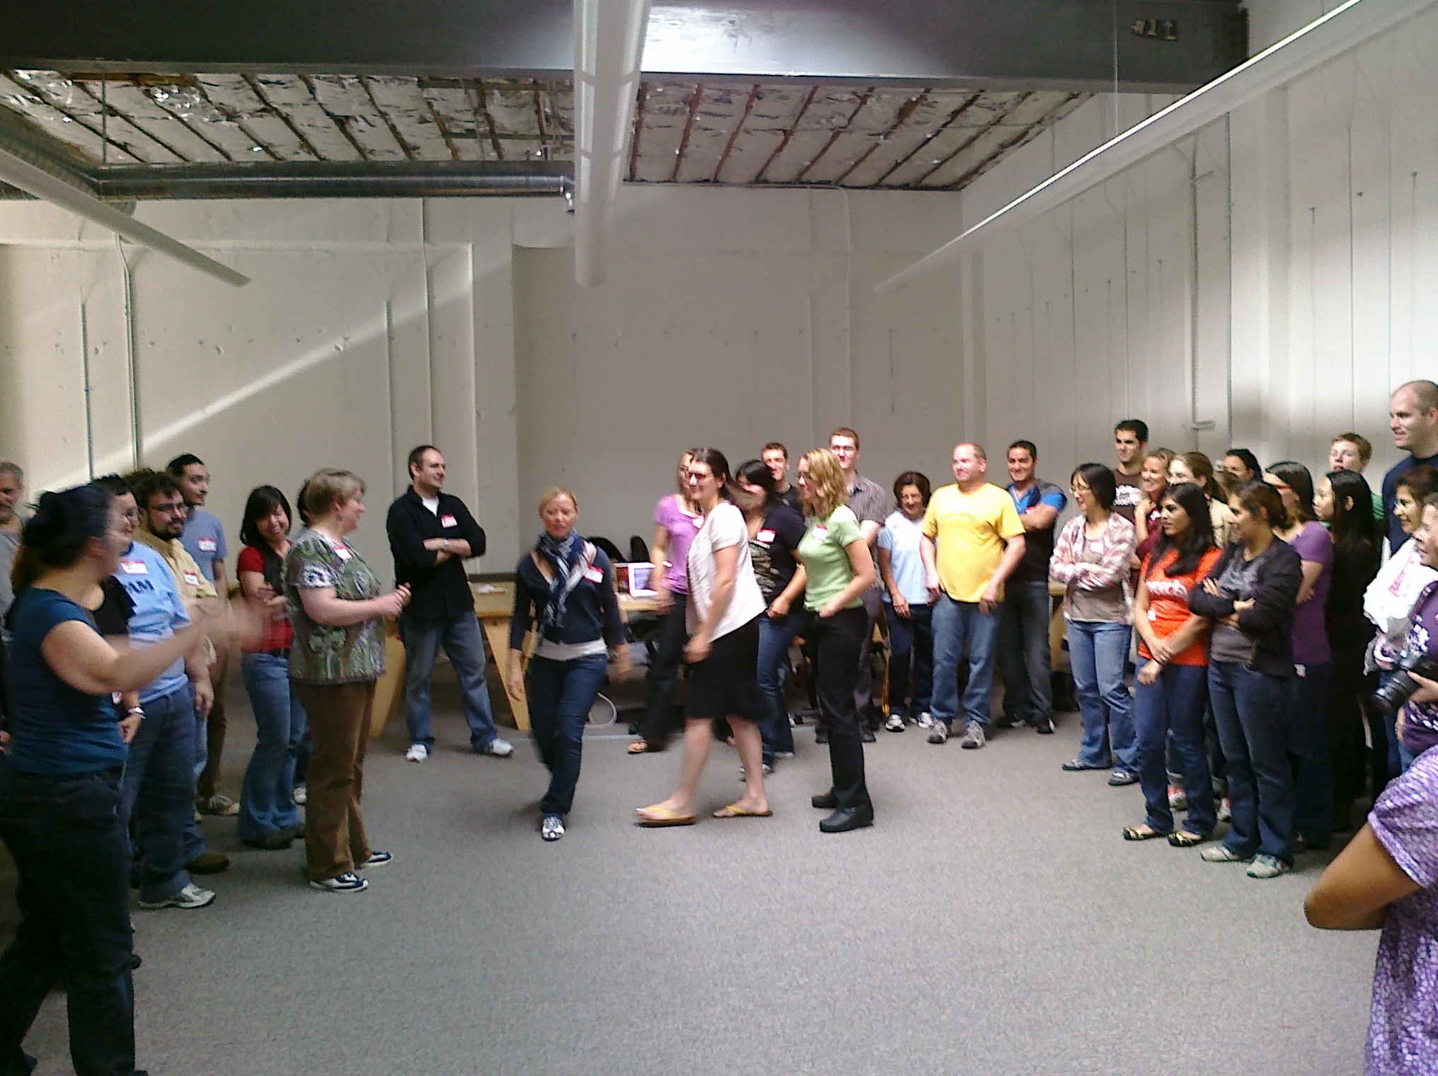

Slide 35
Room Size + OS + Experience
Notes:
Experience:
Ask about experience AND how comfortable are they on the command line.

Slide 36
projectors
“playdate”
Room Size + OS + Experience
Free
Pair organizing
Survey
timekeeper
Food
Small groups
power strips
Volunteer Retrospectives
Nametags
Network
Install Stickers
Notes:
Why Free:
“We most want to attract people who wouldn’t pay to learn this” C++/Java programmers. This gives them a place to start.
This is not a professionally taught class. It’s a community coming together – vulnerability. Free – social obligation – virtuous cycle.
It’s about removing barriers to joining the community.

Slide 37
http://wiki.railsbridge.org/projects/railsbridge/wiki/Workshops

Slide 38
changed
^{WORLD?}
Notes:
Women influence 80% of consumer spending decisions, and yet 90% of technology products and services are designed by men [10]. Including women in the technological design process means more competitive products in the marketplace.
Group diversity leads to better decision outcomes, and this has been shown in a variety of settings, occupations, and organizations [15, 16], and also applies to group task performance [17, 18] and to creativity and innovation [19]. Diversity is beneficial because a variety of opinions, backgrounds, and thinking styles and their integration into the solution are what contribute to better decision outcomes.
A recent industry report estimates that by 2012, teams with gender diversity will double their chances of exceeding performance expectations when compared to all male teams [10].

Slide 39
Notes:
14 workshops and 600+ students later

Slide 41
18%

Slide 42
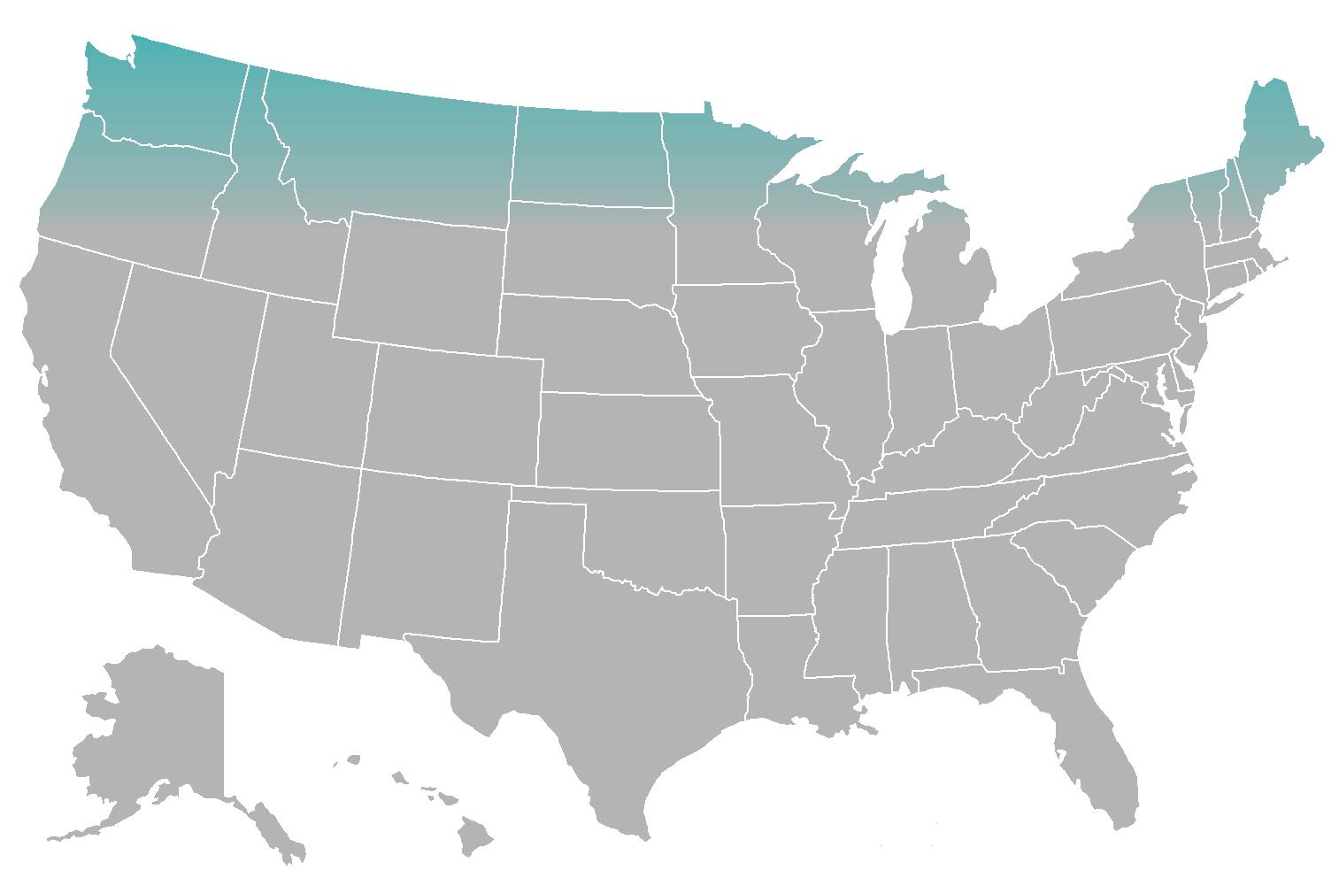
x

Slide 43
x
x
x
x
x
x
x
x
x
Notes:
San Francisco,
South San Francisco,
Seattle,
Hawaii,
Boston,
New York,
Chicago,
Petaluma
AND NOW: PORTLAND!!!!
Volunteer – pdxtechworkshops.org August 19-20

Slide 44
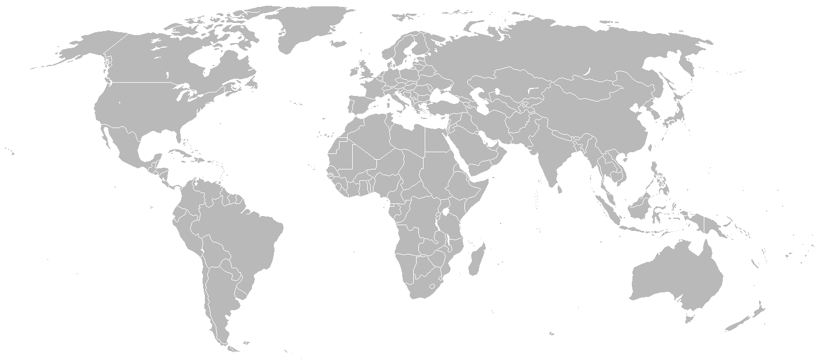
x
x
x
Notes:
Helsinki, Finland RailsGirls
Asunción, Paraguay
Singapore
We have women who have gone through the workshop 3-4 times. One woman who started with no programming experience is now a working software developer in SF.
We’ve helped people make a transition from other languages. I work with two ex java developers who got their first taste of the ruby community at a Railsbridge workshop.
We’re now reaching out to Spanish speakers by translating the curriculum and offering it in spanish. This was driven by a volunteer – choosing the change she wants to make to the diversity of the open source community.
So what can you do to change the world?
Join us! You don’t have to volunteer, you can offer your space, you can help clean up the wiki, you can ask questions
Ruby on Rails not your thing? Pystar.org, Free Geek
Find what you connect with and change the world.

Slide 45
^{questions?}
Railsbridge
  railsbridge.org
me
ilen.org
@ilen
Portland Tech Workshops
pdxtechworkshops.org

